Slide 2

School of Computing Science and Engineering Course Code : BCSE3032 Course Name: SE & TM
ARCHITECTURAL DESIGN
Establishing the overall structure of a software system
Program Name: B.Tech

Slide 3
School of Computing Science and Engineering Course Code : BCSE3032 Course Name: SE & TM
ARCHITECTURAL PARALLELS
Architects are the technical interface between the customer and the contractor building the system.
A bad architectural design for a building cannot be rescued by good construction; the same is true for software.
There are specialist types of building and software architects.
There are schools or styles of building and software architecture.
Program Name: B.Tech

Slide 4
School of Computing Science and Engineering Course Code : BCSE3032 Course Name: SE & TM
SUB-SYSTEMS AND MODULES
A sub-system is a system in its own right whose operation is independent of the services provided by other sub-systems.
A module is a system component that provides services to other components but would not normally be considered as a separate system.
Program Name: B.Tech

Slide 5
School of Computing Science and Engineering Course Code : BCSE3032 Course Name: SE & TM
ARCHITECTURAL MODELS
Structure, control and modular decomposition may be based on a particular model or architectural style.
However, most systems are heterogeneous in that different parts of the system are based on different models and, in some cases, the system may follow a composite model.
The architectural model used affects the performance, robustness, distributability and maintainability of the system.
Program Name: B.Tech

Slide 6
School of Computing Science and Engineering Course Code : BCSE3032 Course Name: SE & TM
WHAT IS ARCHITECTURAL DESIGN?
The process of identifying the sub-systems making up a system and a framework for sub-system communication and control.
A boot-strapping process undertaken in parallel with the abstract specification of sub-systems.
The output of this process is the software architecture.
Program Name: B.Tech

Slide 7
School of Computing Science and Engineering Course Code : BCSE3032 Course Name: SE & TM
“ARCHITECTURAL DESIGN” PROCESS
System structuring – the system is decom-posed into major sub-systems and commun-ication (e.g., data sharing) mechanisms are identified.
Control modelling – a model of the control relationships between the sub-systems is established.
Modular decomposition – the identified sub-systems are decomposed into lower-level modules (components, objects, etc.)
Program Name: B.Tech

Slide 8
School of Computing Science and Engineering Course Code : BCSE3032 Course Name: SE & TM
TERMINOLOGY ISSUES
Modular decomposition is sometimes called high-level (system) design.
A sub-system is usually a system in its own right, and is sometimes called a Product. (or perhaps a stand-alone “increment”)
A module is a lower-level element that would not normally be considered a separate system; modules are sometimes called Components or Objects.
Program Name: B.Tech

Slide 9
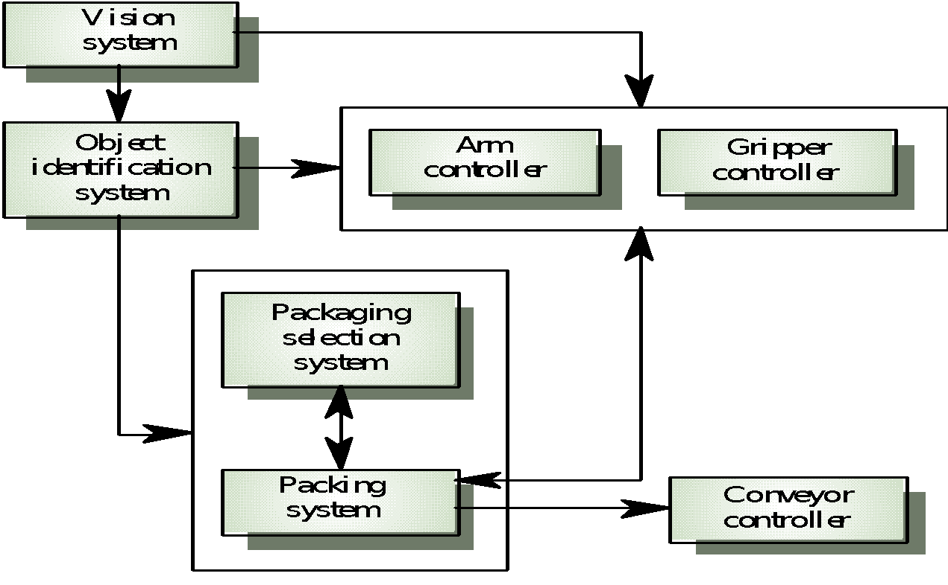
School of Computing Science and Engineering Course Code : BCSE3032 Course Name: SE & TM
EXAMPLE OF A SIMPLE BLOCK DIAGRAM: PACKING ROBOT CONTROL SYSTEM
Program Name: B.Tech

Slide 10
School of Computing Science and Engineering Course Code : BCSE3032 Course Name: SE & TM
DESIGN STRATEGIES
Functional design
The system is designed from a functional viewpoint.
The system state is centralized and shared between the functions operating on that state.
Object-oriented design
The system is viewed as a collection of interacting objects.
The system state is decentralized and each object manages its own state.
Objects may be instances of an object class and communicate by exchanging methods.
Program Name: B.Tech

Slide 11
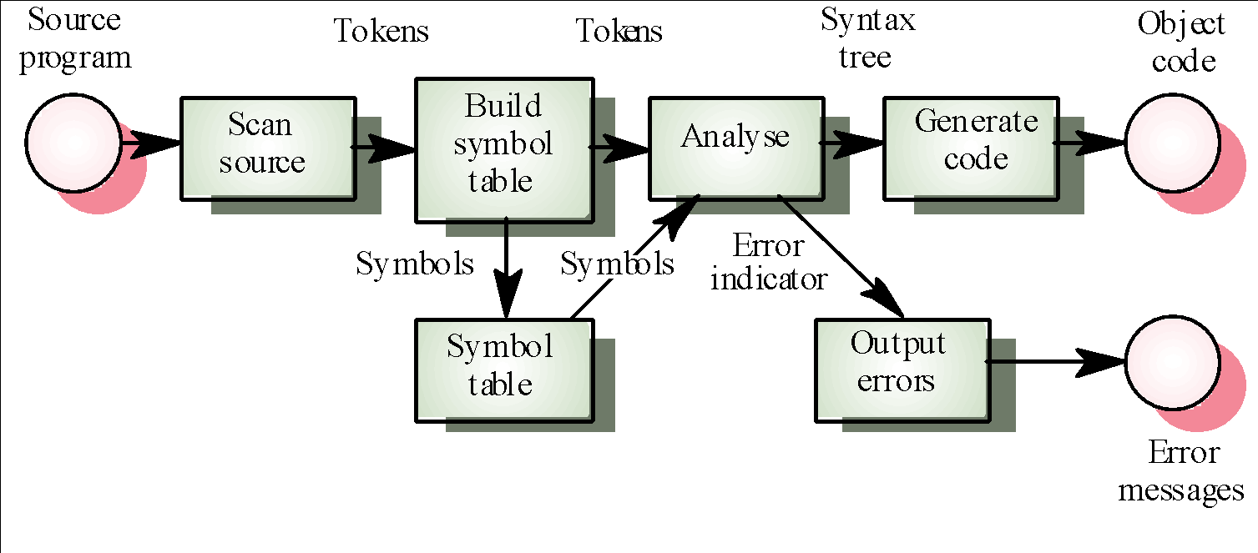
School of Computing Science and Engineering Course Code : BCSE3032 Course Name: SE & TM
FUNCTIONAL VIEW OF A COMPILER
Program Name: B.Tech

Slide 12
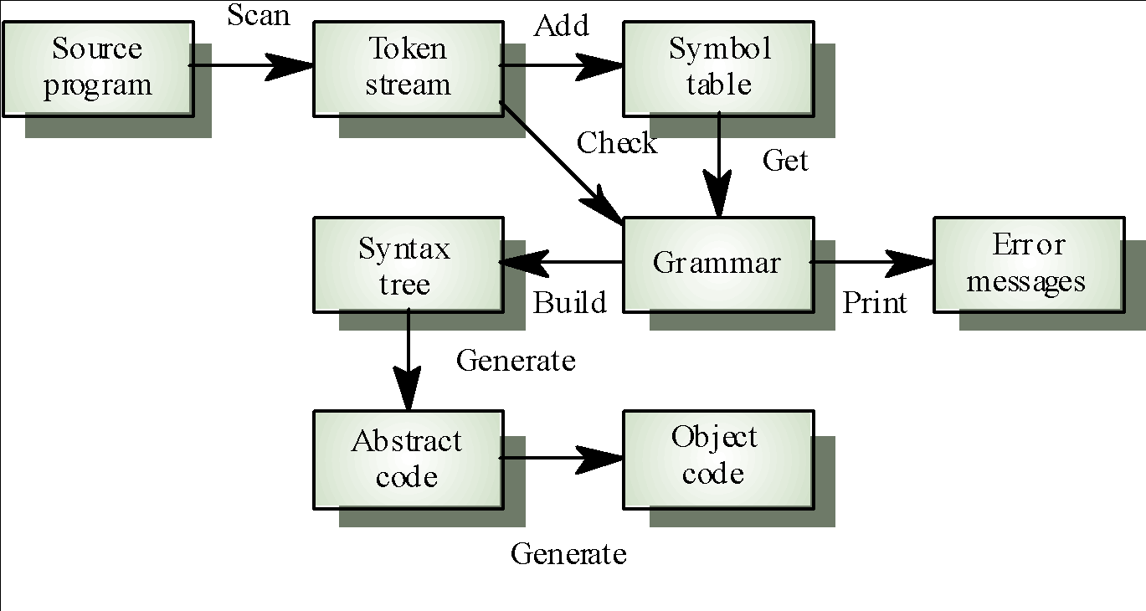
School of Computing Science and Engineering Course Code : BCSE3032 Course Name: SE & TM
OBJECT-ORIENTED VIEW OF A COMPILER
Program Name: B.Tech

Slide 13
School of Computing Science and Engineering Course Code : BCSE3032 Course Name: SE & TM
DESIGN QUALITY
Design quality is an elusive concept. Quality depends on specific organizational priorities.
A “good” design may be the most efficient, the cheapest, the most maintainable, the most reliable, etc.
The attributes discussed here are concerned with the maintainability of the design.
Quality characteristics are equally applicable to function-oriented and object-oriented designs.
Program Name: B.Tech

Slide 14
School of Computing Science and Engineering Course Code : BCSE3032 Course Name: SE & TM
UNIT-2
Software Requirement Specifications (SRS) and Design:
Low Level Design:
Modularization,
Design Structure Charts,
Pseudo Codes,
Program Name: B.Tech

Slide 15
School of Computing Science and Engineering Course Code : BCSE3032 Course Name: SE & TM
MODULARIZATION
Modularization is a technique to divide a software system into multiple discrete and independent modules, which are expected to be capable of carrying out task(s) independently.
Designers tend to design modules such that they can be executed and/or compiled separately and independently.
Program Name: B.Tech

Slide 16
School of Computing Science and Engineering Course Code : BCSE3032 Course Name: SE & TM
ADVANTAGE OF MODULARIZATION
Smaller components are easier to maintain
Program can be divided based on functional aspects
Desired level of abstraction can be brought in the program
Components with high cohesion can be re-used again
Concurrent execution can be made possible
Desired from security aspect
Program Name: B.Tech

Slide 17
School of Computing Science and Engineering Course Code : BCSE3032 Course Name: SE & TM
STRUCTURE CHART
Structure Chart represent hierarchical structure of modules.
It breaks down the entire system into lowest functional modules, describe functions and sub-functions of each module of a system to a greater detail.
Program Name: B.Tech

Slide 18
School of Computing Science and Engineering Course Code : BCSE3032 Course Name: SE & TM
SYMBOLS USED IN CONSTRUCTION OF STRUCTURED CHART
Module It represents the process or task of the system. It is of three types.
Control Module A control module branches to more than one sub module.
Sub Module Sub Module is a module which is the part (Child) of another module.
Library Module Library Module are reusable and invokable from any module.
Program Name: B.Tech

Slide 19
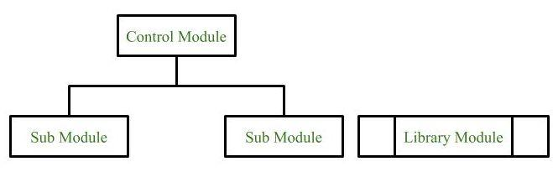
School of Computing Science and Engineering Course Code : BCSE3032 Course Name: SE & TM
MODULE
Program Name: B.Tech

Slide 20
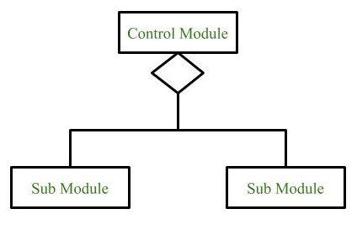
School of Computing Science and Engineering Course Code : BCSE3032 Course Name: SE & TM
CONDITIONAL CALL
It represents that control module can select any of the sub module on the basis of some condition.
Program Name: B.Tech

Slide 21
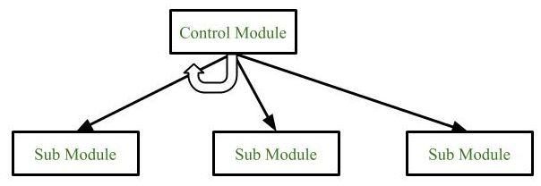
School of Computing Science and Engineering Course Code : BCSE3032 Course Name: SE & TM
LOOP (REPETITIVE CALL OF MODULE)
It represents the repetitive execution of module by the sub module.
A curved arrow represents loop in the module.
Program Name: B.Tech

Slide 22
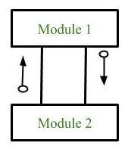
School of Computing Science and Engineering Course Code : BCSE3032 Course Name: SE & TM
DATA FLOW
It represents the flow of data between the modules. It is represented by directed arrow with empty circle at the end.
Program Name: B.Tech

Slide 23
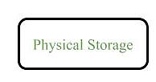
School of Computing Science and Engineering Course Code : BCSE3032 Course Name: SE & TM
PHYSICAL STORAGE
Physical Storage is that where all the information are to be stored.
Program Name: B.Tech

Slide 24
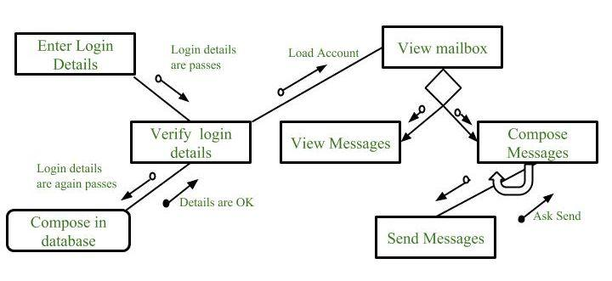
School of Computing Science and Engineering Course Code : BCSE3032 Course Name: SE & TM
STRUCTURE CHART FOR AN EMAIL SERVER
Program Name: B.Tech

Slide 25
School of Computing Science and Engineering Course Code : BCSE3032 Course Name: SE & TM
PSEUDO CODE
It is a methodology that allows the programmer to represent the implementation of an algorithm.
cooked up representation of an algorithm.
These include while, do, for, if, switch. Examples below will illustrate this notion
Program Name: B.Tech

Slide 26
School of Computing Science and Engineering Course Code : BCSE3032 Course Name: SE & TM
PSEUDO CODE EXAMPLE 1
If student's grade is greater than or equal to 60
Print "passed"
else
Print "failed"
Program Name: B.Tech

Slide 27
School of Computing Science and Engineering Course Code : BCSE3032 Course Name: SE & TM
PSEUDO CODE EXAMPLE 2
Pseudocode
While the power of 2 is not larger than 1000
keep on getting the values of the power of 2.
C++ statement
int product = 2;
while ( product <= 1000 )
product = 2 * product;
Program Name: B.Tech

Slide 28
School of Computing Science and Engineering Course Code : BCSE3032 Course Name: SE & TM
UNIT-2
Software Requirement Specifications (SRS) and Design:
Flow Charts, Coupling and Cohesion Measures
Program Name: B.Tech

Slide 29
School of Computing Science and Engineering Course Code : BCSE3032 Course Name: SE & TM
FLOW CHARTS
Also called: process flowchart, process flow diagram
A flowchart is a picture of the separate steps of a process in sequential order.
It is a generic tool that can be adapted for a wide variety of purposes, and can be used to describe various processes, such as a manufacturing process, an administrative or service process, or a project plan.
Program Name: B.Tech

Slide 30
School of Computing Science and Engineering Course Code : BCSE3032 Course Name: SE & TM
FLOW CHARTS
WHEN TO USE A FLOWCHART
To develop understanding of how a process is done
To study a process for improvement
To communicate to others how a process is done
When better communication is needed between people involved with the same process
To document a process
When planning a project
Program Name: B.Tech

Slide 31
School of Computing Science and Engineering Course Code : BCSE3032 Course Name: SE & TM
FLOW CHARTS
FLOWCHART BASIC PROCEDURE
Define the process to be diagrammed. Write its title at the top of the work surface.
Discuss and decide on the boundaries of your process: Where or when does the process start? Where or when does it end? Discuss and decide on the level of detail to be included in the diagram.
Arrange the activities in proper sequence.
.
Program Name: B.Tech

Slide 32
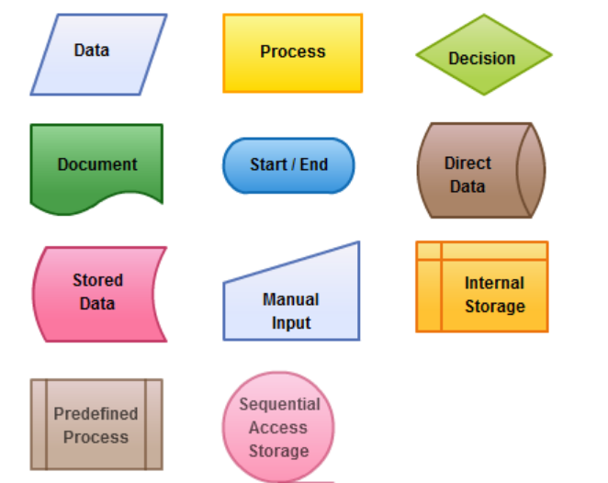
School of Computing Science and Engineering Course Code : BCSE3032 Course Name: SE & TM
FLOW CHARTS SYMBOLS MEANING
Program Name: B.Tech

Slide 33
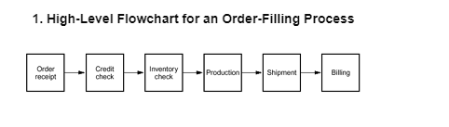
School of Computing Science and Engineering Course Code : BCSE3032 Course Name: SE & TM
FLOW CHARTS
Program Name: B.Tech

Slide 34
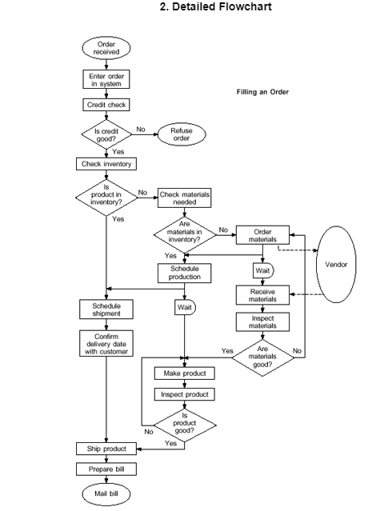
School of Computing Science and Engineering Course Code : BCSE3032 Course Name: SE & TM
FLOW CHARTS
Program Name: B.Tech

